Slide 1
Learning to Fly by Crashing – Gandhi et al
Implementation by Murtaza Rangwala

Slide 2
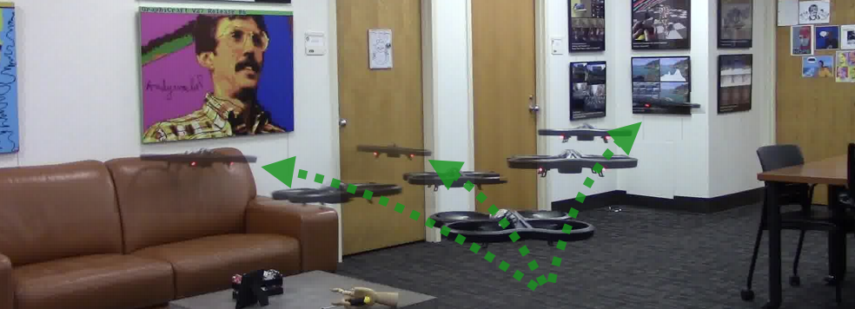
What they did?

Slide 3
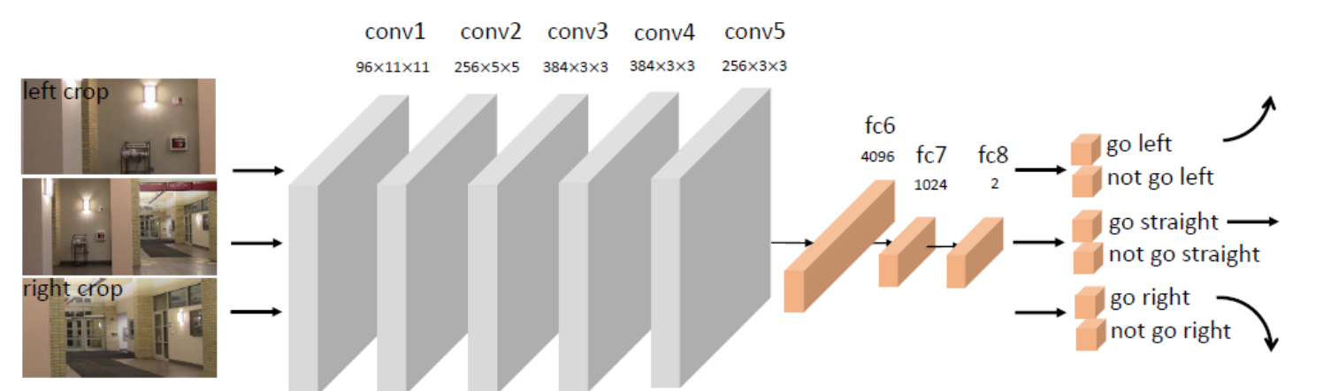
AlexNet Architecture

Slide 4
Training
Convolutional
1.2 Million Images, across 1000 categories, ILSVRC Database
Pre-Trained Weights from BVLC, University of Toronto
Fully Connected
208,597 – Crash Test Images for Fully Connected Layers
Images in the middle were ignored

Slide 5
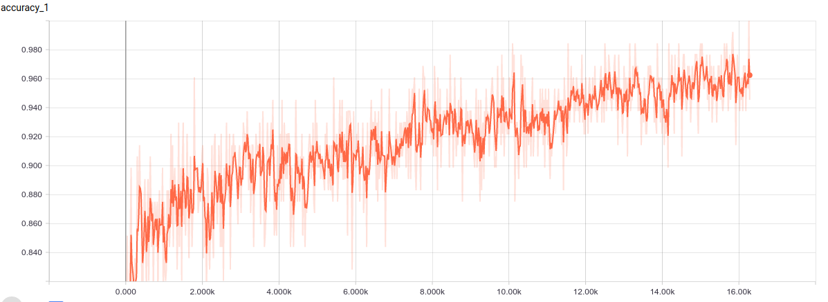
Modified AlexNet Topology ~95% Accuracy

Slide 6
Stock AlexNet Topology ~96% Accuracy

Slide 7

Test Images
Left Crop
Right Crop
Straight Collision Probability - 0.38619134
Left Crop Collision Probability - 0.41573554
Right Crop Collision Probability - 0.3925606

Slide 8
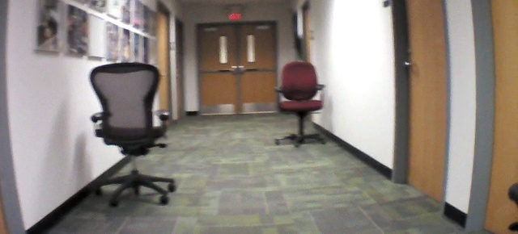
Test Image
Left Crop
Right Crop
Straight Collision Probability - 0.32223415
Left Crop Collision Probability - 0.31853414
Right Crop Collision Probability - 0.32828245

Slide 9
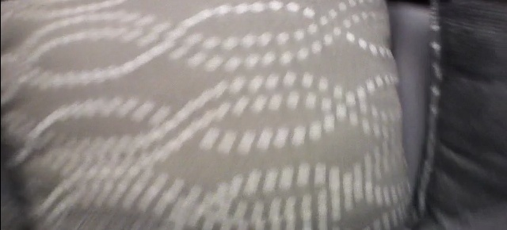
Test Image
Left Crop
Right Crop
Straight Collision Probability - 0.69555986
Left Crop Collision Probability - 0.66660941
Right Crop Collision Probability - 0.70258272

Slide 10
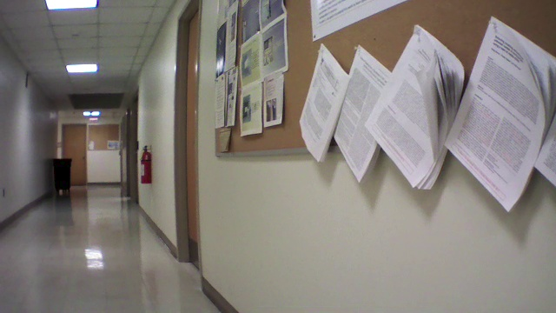
Test Image
Left Crop
Right Crop
Straight Collision Probability - 0.31027898
Left Crop Collision Probability - 0.27729002
Right Crop Collision Probability - 0.49395087

Slide 11
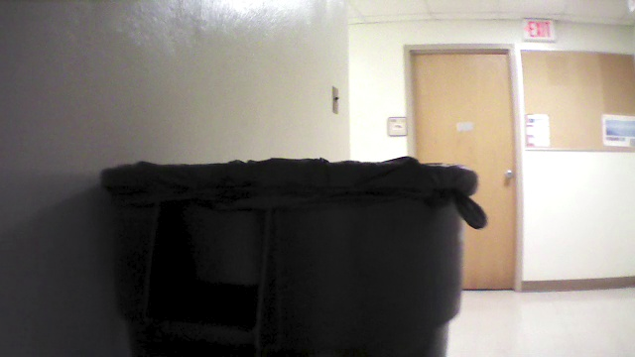
Test Image
Left Crop
Right Crop
Straight Collision Probability – 0.7146821
Left Crop Collision Probability - 0.6664021
Right Crop Collision Probability - 0.48939261

Slide 12
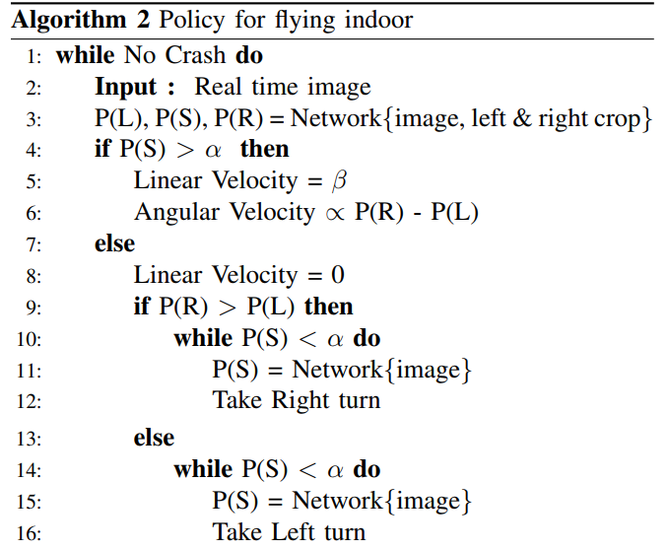
Algorithm

Slide 13
Future Work
Further training of the network for desired results
Tuning of velocity commands on the drone for stabilization
Angular Velocity on the drone tends to destabilize it

